Slide 1

XSL & XSLT By Dr Shridevi S, Associate Professor, SCOPE, VIT

Slide 2
What is XSL?
XSL stands for Extensible Stylesheet Language
CSS was designed for styling HTML pages, and can be used to style XML pages
XSL was designed specifically to style XML pages, and is much more sophisticated than CSS
XSL consists of three languages:
XSLT (XSL Transformations) is a language used to transform XML documents into other kinds of documents (most commonly HTML, so they can be displayed)
XPath is a language to select parts of an XML document to transform with XSLT

Slide 3
How does it work?
The XML source document is parsed into an XML source tree
You use XPath to define templates that match parts of the source tree
You use XSLT to transform the matched part and put the transformed information into the result tree
The result tree is output as a result document
Parts of the source document that are not matched by a template are typically copied unchanged

Slide 4
Simple XPath
XPath expressions look a lot like paths in a computer file system
/ means the document itself (but no specific elements)
/library selects the root element
/library/book selects every book element
//author selects every author element, wherever it occurs
Here’s a simple XML document:
<?xml version="1.0"?> <library> <book> <title>XML</title> <author>Gregory Brill</author> </book> <book> <title>Java and XML</title> <author>Brett McLaughlin</author> </book> </library >

Slide 5
Simple XSLT
<xsl:for-each select="//book"> loops through every book element, everywhere in the document
<xsl:value-of select="title"/> chooses the content of the title element at the current location
<xsl:for-each select="//book"> <xsl:value-of select="title"/> </xsl:for-each> chooses the content of the title element for each book in the XML document

Slide 6
Using XSL to create HTML
Our goal is to turn this:
<?xml version="1.0"?> <library> <book> <title>XML</title> <author>Gregory Brill</author> </book> <book> <title>Java and XML</title> <author>Brett McLaughlin</author> </book> </library >
Into HTML that displays something like this:
Book Titles: • XML • Java and XML Book Authors: • Gregory Brill • Brett McLaughlin
Note that we’ve grouped titles and authors separately

Slide 7
What we need to do
We need to save our XML into a file (let’s call it books.xml)
We need to create a file (say, books.xsl) that describes how to select elements from books.xml and embed them into an HTML page
We do this by intermixing the HTML and the XSL in the books.xsl file
We need to add a line to our books.xml file to tell it to refer to books.xsl for formatting information

Slide 8
books.xml, revised
<?xml version="1.0"?> <?xml-stylesheet type="text/xsl" href="books.xsl"?> <library> <book> <title>XML</title> <author>Gregory Brill</author> </book> <book> <title>Java and XML</title> <author>Brett McLaughlin</author> </book> </library >

Slide 9
Desired HTML
<html> <head> <title>Book Titles and Authors</title> </head> <body> <h2>Book titles:</h2> <ul> <li>XML</li> <li>Java and XML</li> </ul> <h2>Book authors:</h2> <ul> <li>Gregory Brill</li> <li>Brett McLaughlin</li> </ul> </body> </html>
Blue text is data extracted from the XML document
Brown text is our HTML template
We don’t necessarily know how much data we will have

Slide 10
XSL outline
<?xml version="1.0" encoding="ISO-8859-1"?>
<xsl:stylesheet version="1.0" xmlns:xsl="http://www.w3.org/1999/XSL/Transform">
<xsl:template match="/">
<html> ... </html>
</xsl:template>
</xsl:stylesheet>

Slide 11
Selecting titles and authors
<h2>Book titles:</h2> <ul> <xsl:for-each select="//book"> <li> <xsl:value-of select="title"/> </li> </xsl:for-each> </ul> <h2>Book authors:</h2> ...same thing, replacing title with author
Notice that XSL can rearrange the data; the HTML result can present information in a different order than the XML
Notice the xsl:for-each loop

Slide 12
All of books.xml
<?xml version="1.0"?> <?xml-stylesheet type="text/xsl" href="books.xsl"?> <library> <book> <title>XML</title> <author>Gregory Brill</author> </book> <book> <title>Java and XML</title> <author>Brett McLaughlin</author> </book> </library >
Note: if you do View Source, this is what you will see, not the resultant HTML

Slide 13
All of books.xsl
<h2>Book authors:</h2> <ul> <xsl:for-each select="//book"> <li> <xsl:value-of select="author"/> </li> </xsl:for-each> </ul> </body> </html> </xsl:template> </xsl:stylesheet>
<?xml version="1.0" encoding="ISO-8859-1"?> <xsl:stylesheet version="1.0" xmlns:xsl="http://www.w3.org/1999/ XSL/Transform"> <xsl:template match="/"> <html> <head> <title>Book Titles and Authors</title> </head> <body> <h2>Book titles:</h2> <ul> <xsl:for-each select="//book"> <li> <xsl:value-of select="title"/> </li> </xsl:for-each> </ul>

Slide 14
How to use it
In a modern browser, such as Netscape 6, Internet Explorer 6, or Mozilla 1.0, you can just open the XML file
Older browsers will ignore the XSL and just show you the XML contents as continuous text
You can use a program such as Xalan, MSXML, or Saxon to create the HTML as a file
This can be done on the server side, so that all the client side browser sees is plain HTML
The server can create the HTML dynamically from the information currently in XML

Slide 15
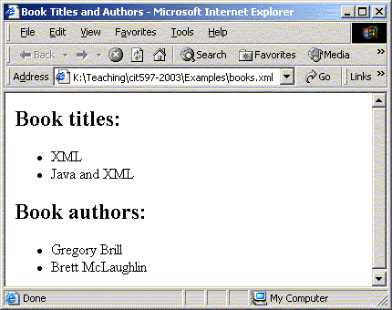
The result (in IE)

Slide 16
Need for XSL
In case of HTML document, tags are predefined such as table, div, and span; and the browser knows how to add style to them and display those using CSS styles.
But in case of XML documents, tags are not predefined. In order to understand and style an XML document, World Wide Web Consortium (W3C) developed XSL which can act as XML based Stylesheet Language.
An XSL document specifies how a browser should render an XML document.
Following are the main parts of XSL −
XSLT − used to transform XML document into various other types of document.
XPath − used to navigate XML document.
2

Slide 17
XSLT
XSL has two independent languages:
The XSL Transformation Language (XSLT)
The XSL Formatting Object Language (XSL-FO)
XSLT is used to convert an XML document to another format.
XSL-FO provides a way of describing the presentation of an XML document.
Both technologies use a supporting XML technology, XPath.
Xpath defines a standard mechanism for accessing elements within a document.

Slide 18
XSLT for Document Publishing
XSL technology has an important role in the field of document publishing.
Using XSL, we can convert the XML document to an HTML file, PDF document, or other format.
By applying an XSL style sheet, we render a new view of the data.
The development of multiple style sheets allows us to have multiple views of the same data.

Slide 19
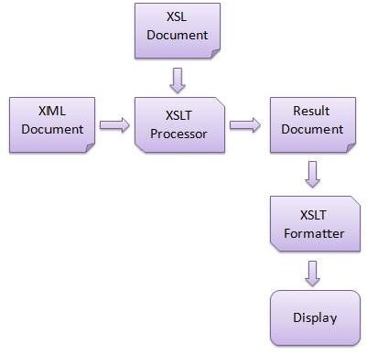
4

Slide 20
XSLT
XSLT provides the mechanism for converting an XML document to another format.
This is accomplished by applying an XSLT style sheet to the XML document.
The style sheet contains conversion rules for accessing and transforming the input XML document to a different output format.
An XSLT processor is responsible for applying the rules defined in the style sheet to the input XML document.

Slide 21
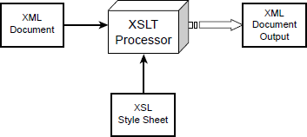
XSLT

Slide 22
Creating the XSL Style Sheet
An XSL style sheet has the following general structure:
<?xml version=”1.0”?>
<xsl:stylesheet xmlns:xsl=”URI” version=”1.0”>
<!--XSL-T CONVERSION RULES-->
</xsl:stylesheet>
The <xsl:stylesheet> element defines how the XSLT processor should process the current XSL document.
The xmlns attribute is the namespace definition.
The XSL Transformation engine reads the xmlns attribute and
determines whether it supports the given namespace.
The xmlns attribute specifies the XSL prefix.
All XSL elements and types in the document use the prefix.

Slide 23
<xsl:template> element
The XSL elements are template rules for the XSLT processor.
A template is associated with a given element in the XML document.
A template is defined to match on the <book> element using the following code:
<xsl:template match=”/book”>
<!--static text and xsl rules -->

Slide 24
<xsl:value-of> element
The <xsl:value-of> element contains a select attribute.
This attribute value is the name of the actual XML element you want to retrieve.
For example, the following code will retrieve the title of the book:
<xsl:value-of select=”title” />

Slide 25
Example 1
<?xml version="1.0" encoding="UTF-8"?>
<catalog>
<cd>
<title>Empire Burlesque</title>
<artist>Bob Dylan</artist>
<country>USA</country>
<company>Columbia</company>
<price>10.90</price>
<year>1985</year>
</cd>
<cd>
<title>Hide your heart</title>
<artist>Bonnie Tyler</artist>
<country>UK</country>
<company>CBS Records</company>
<price>9.90</price>
<year>1988</year>
</cd>
</catalog>

Slide 26
Example 1
<?xml version="1.0" encoding="UTF-8"?>
<xsl:stylesheet version="1.0“ xmlns:xsl="http://www.w3.org/1999/XSL/Transform">
<xsl:template match="/">
<html>
<body>
<h2>My CD Collection</h2>
<table border="1">
<tr bgcolor="#9acd32">
<th>Title</th> <th>Artist</th>
</tr>

Slide 27
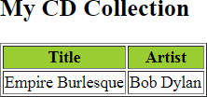
Example 1
<tr>
<td><xsl:value-of select="catalog/cd/title"/></td>
<td><xsl:value-of select="catalog/cd/artist"/></td>
</tr>
</table>
</body>
</html>
</xsl:template>
</xsl:stylesheet>

Slide 28
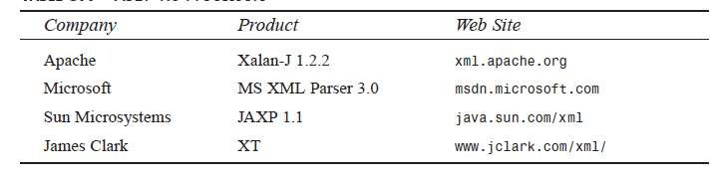
The XSLT Processor
two techniques are available for performing the XSLT processing: client-side processing and server-side processing.

Slide 29
Client-side XSLT processing
Client-side XSLT processing commonly occurs in a Web browser.
The Web browser includes an XSLT processor and retrieves the XML document and XSL style sheet
The client-side technique offloads the XSLT processing to the client machine.
This minimizes the workload on the Web server.
However, the disadvantage is that the Web browser must provide XSLT support.

Slide 30
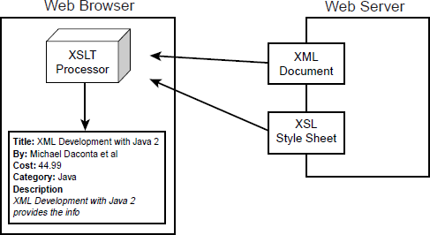
Client-side XSLT processing

Slide 31
Server-side XSLT processing
Server-side XSLT processing occurs on the Web server or application server.
A server side process such as an Active Server Page (ASP), Java Server Page (JSP), or Java servlet will retrieve the XML document and XSL style sheet and pass them to an XSLT processor.
The output of the XSLT processor is sent to the client Web browser for presentation.
The output is generally a markup language, such as HTML, that is understood by the client browser.

Slide 32
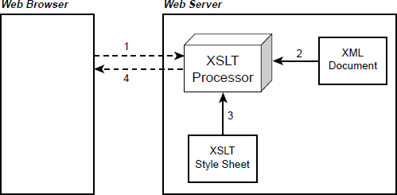
Server-side XSLT processing

Slide 33
Example
<?xml version=”1.0”?>
<?xml-stylesheet type=”text/xsl” href=”book_view.xsl”?>
<book>
<author>Michael Daconta et al</author>
<title>XML Development with Java 2</title>
<category>Java</category>
<price currency=”USD”>44.99</price>
<summary>
XML Development with Java 2 provides the information
and techniques a Java developer will need to integrate
XML into Java-based applications.
</summary>

Slide 34
Example
<?xml version=”1.0”?>
<xsl:stylesheet xmlns:xsl=http://www.w3.org/1999/XSL/Transform
version=”1.0”>
<xsl:template match=”/book”>
<html>
<body><b>Title: </b> <xsl:value-of select=”title” />
<p> <b>By: </b> <xsl:value-of select=”author” />
<p> <b>Cost: </b> <xsl:value-of select=”price” />
<p/>
<p/>
<p> <b>Category: </b> <xsl:value-of select=”category” /> <p/>
<p> <b>Description</b> <i><xsl:value-of select=”summary” /></i></p>
</body></html></xsl:template></xsl:stylesheet>

Slide 35
Example
<%@ Language=VBScript %>
<% set xml = Server.CreateObject(“Microsoft.XMLDOM”)
xml.load(Server.MapPath(“book.xml”))
set xsl = Server.CreateObject(“Microsoft.XMLDOM”)
xsl.load(Server.MapPath(“book_view.xsl”)) Response.Write(xml.transformNode(xsl))
%>

Slide 36
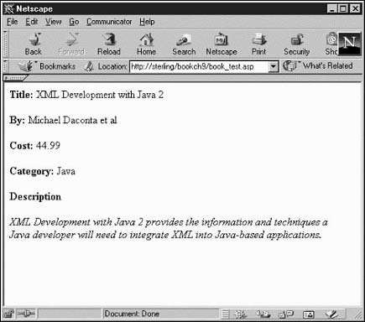
Example

Slide 37
Looping
The XSLT element <xsl:for-each> is used for looping through a list of
elements.
This is very useful when you have a collection of related items to process them in a sequential fashion.
The <xsl:for-each> element is commonly used in the Web development world to convert an XML document to an HTML table.
<xsl:for-each select=node-set-expression>
<!-- content -->
</xsl:for-each>
The <xsl:for-each> element has a required attribute: select.

Slide 38
Example
<?xml version=”1.0”?>
<xsl:stylesheet xmlns:xsl=”http://www.w3.org/1999/XSL/Transform”
version=”1.0”>
<xsl:template match=”/”>
<html><body>
<h3>Looping Example</h3>
<hr></hr>
<table border=”1” cellpadding=”5”>
<tr>
<th>Author</th>
<th>Title</th>
<th>Category</th>
<th>Price</th>
</tr>

Slide 39
Example
<xsl:for-each select=”booklist/book” >
<tr>
<td> <xsl:value-of select=”author” /> </td>
<td> <xsl:value-of select=”title” /> </td>
<td> <xsl:value-of select=”category” /> </td>
<td> <xsl:value-of select=”price” /> </td>
</tr>
</xsl:for-each>
</table>
</body></html></xsl:template></xsl:stylesheet>

Slide 40
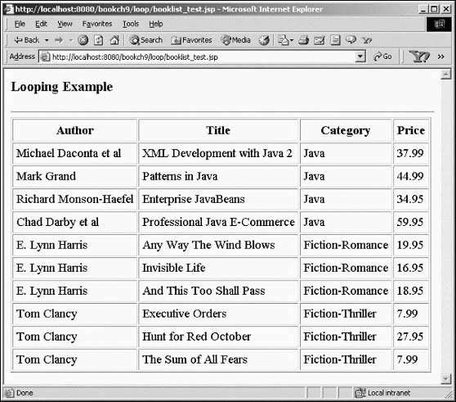
Example

Slide 41
Sorting
<xsl:sort> element is used for sorting the XML data.
It is possible to sort based on a single key or multiple keys.
<xsl:sort
select = string-expression
order = { “ascending” | “descending” }
data-type = { “text” | “number” }
case-order = {“upper-first” | “lower-first” } lang = { nmtoken } />
The <xsl:sort> element is used in conjunction with the
<xsl:for-each> element.

Slide 42
Sorting
Following code snippet sorts the book titles in alphabetical order:
<!-- Sort by the book title -->
<xsl:for-each select=”booklist/book” >
<xsl:sort select=”title” />
<!-- insert table rows and table data -->
</xsl:for-each>

Slide 43
Example
<xsl:for-each select=”booklist/book” >
<xsl:sort select=”price” order=”ascending” data-type=”number” />
<tr>
<td> <xsl:value-of select=”author” /> </td>
<td> <xsl:value-of select=”title” /> </td>
<td> <xsl:value-of select=”category” /> </td>
<td> <xsl:value-of select=”price” /> </td>
</tr>
</xsl:for-each>

Slide 44
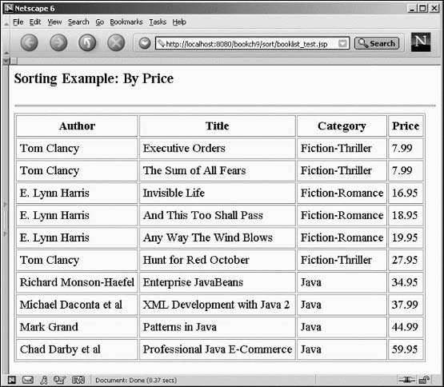
Example

Slide 45
Sorting with Multiple Keys
<xsl:for-each select=”booklist/book” >
<xsl:sort select=”category” />
<xsl:sort select=”price” data-type=”number” />
<tr>
<td> <xsl:value-of select=”author” /> </td>
<td> <xsl:value-of select=”title” /> </td>
<td> <xsl:value-of select=”category” /> </td>
<td> <xsl:value-of select=”price” /> </td>
</tr>
</xsl:for-each>

Slide 46
Conditionals
During an XSLT transformation, the style sheet can perform conditional tests on the data.
XSLT contains a very simple if-then conditional.
<xsl:if test=Boolean-expression>
<!-- content -->
</xsl:if>
The test attribute refers to a Boolean expression.
If the Boolean expression evaluates to true, the content within the <xsl:if> element is included in the output.

Slide 47
Example
<xsl:for-each select=”booklist/book” >
<tr>
<xsl:if test=”category=’Fiction-Thriller’”>
<xsl:attribute name=”bgcolor”>red</xsl:attribute>
</xsl:if>
<td> <xsl:value-of select=”author” /> </td>
<td> <xsl:value-of select=”title” /> </td>
<td> <xsl:value-of select=”category” /> </td>
<td> <xsl:value-of select=”price” /> </td>
</tr></xsl:for-each>

Slide 48
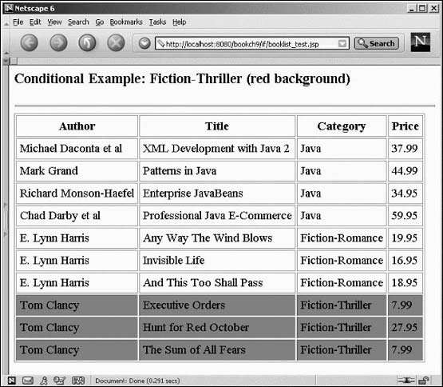
Example

Slide 49
Filters
XSLT can also filter the data based on a given expression.
When data is selected using the <xsl:for-each> element, the expression can contain a filter.
For example, you can filter the data to contain only Java books.

Slide 50
Example
<xsl:for-each select=”booklist/book[category=’Java’]”>
<tr>
<td> <xsl:value-of select=”author” /> </td>
<td> <xsl:value-of select=”title” /> </td>
<td> <xsl:value-of select=”category” /> </td>
<td> <xsl:value-of select=”price” /> </td>
</tr></xsl:for-each>

Slide 51
<xsl:choose> Element
The <xsl:choose> element is used in conjunction with <xsl:when> and <xsl:otherwise> to express multiple conditional tests.
<xsl:choose>
<xsl:when test="expression">
... some output ...
</xsl:when>
<xsl:otherwise>
... some output ....
</xsl:otherwise>
</xsl:choose>

Slide 52
<xsl:choose> Element
<xsl:for-each select=”booklist/book” >
<tr>
<td> <xsl:value-of select=”title” /> </td>
<xsl:choose>
<xsl:when test="price &gt; 10">
<td bgcolor="#ff00ff">
<xsl:value-of select=“author"/></td>
</xsl:when>
<xsl:otherwise>
<td><xsl:value-of select=“author"/></td>
</xsl:otherwise>
</xsl:choose></xsl:for-each>

Slide 53
Summary
An XSLT stylesheet is used to define the transformation rules to be applied on the target XML document.
XSLT stylesheet is written in XML format. XSLT Processor takes the XSLT stylesheet and applies the transformation rules on the target XML document and then it generates a formatted document in the form of XML, HTML, or text format.
This formatted document is then utilized by XSLT formatter to generate the actual output which is to be displayed to the end-user.
Independent of programming is a big advantage. Transformations are written in a separate xsl file which is again an XML document.
Output can be altered by simply modifying the transformations in xsl file. No need to change any code. So Web designers can edit the style sheet and can see the change in the output quickly.

